Slide 1
Choosing a City to Live in Orange County California

Slide 2
Background
I have decided I want to move to Orange County California
With many cities to choose from, I will need to determine which I would enjoy the most
I enjoy going to breweries, so I will analyze cities with a high density of breweries

Slide 3
Data Acquisition and Cleaning
City and zip code data scraped from https://www.zipcodestogo.com
Duplicate cities (different zip codes) were dropped
Venue data pulled from Foursquare API

Slide 4
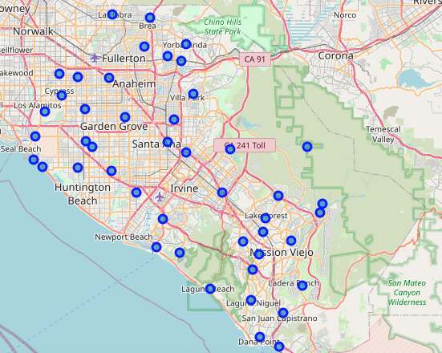
Visualize Cities in Orange County

Slide 5
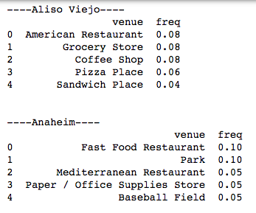
View Top Venue Categories by City

Slide 6
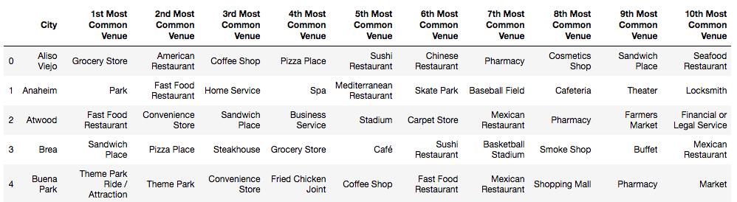
Sort by Most Common Venue in Each City

Slide 7
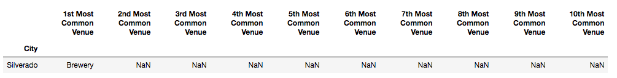
Find Cities that Include Brewery

Slide 8
Conclusion
Silverado is the only city where Brewery was included as a top venue
This will be my starting point for future analysis
Additional analyses that will need to be performed will include house prices, schools, crime, etc. but this is a good place to start

